Slide 1
ReviewSense – Milestone 2: Sentiment Analysis & Visualization

Slide 2
Sentiment Analysis & Visualization
Project Goal: Convert customer feedback into measurable sentiment insights using Natural Language Processing (NLP).
Focus: Classify feedback as Positive, Negative, or Neutral and visualize results.

Slide 3
Problem Statement
Why Do We Need This?
Businesses receive large amounts of customer feedback.
Manual analysis is slow and inefficient.
Hard to understand overall customer satisfaction.
Solution:
Use Automated Sentiment Analysis to:
Detect customer emotions
Measure satisfaction levels
Support better decision-making

Slide 4
Objective of Milestone 2
Main Objective
Analyze cleaned feedback (from Milestone 1) to:
Classify sentiment (Positive / Negative / Neutral)
Generate a confidence score
Create a visual summary
Save results for future analysis
This milestone transforms text into meaningful business insights.

Slide 5
Technologies Used
🛠 Tools & Libraries
Python – Programming language
pandas – Data processing
TextBlob – Sentiment analysis
matplotlib – Data visualization
Easy to use
Powerful for text analysis
Reproducible workflow

Slide 6
How the System Works
⚙ Step-by-Step Workflow
Read cleaned feedback CSV file
Use TextBlob to calculate polarity score
Apply rules:
Polarity > 0 → Positive
Polarity < 0 → Negative
Polarity = 0 → Neutral
Store sentiment + confidence score
Generate bar chart visualization
Save updated dataset

Slide 7
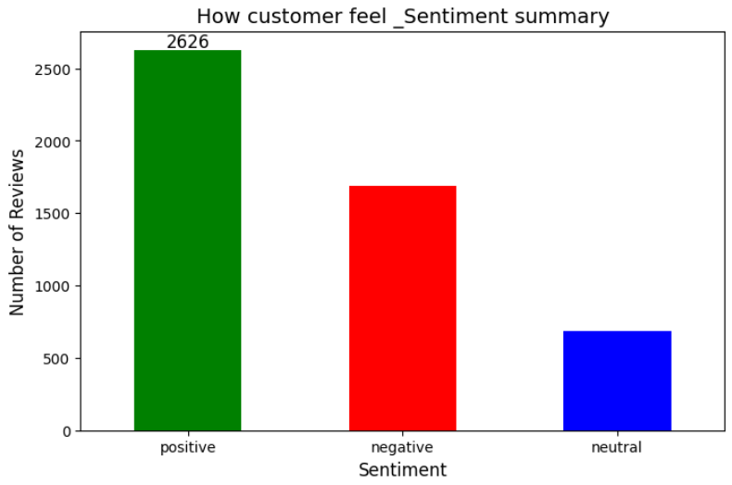
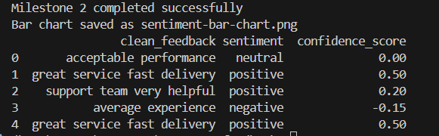
Input & Output
Input:
Milestone1_Cleaned_Feedback.csv
Output Files:
Milestone2_Sentiment_Results_new.csv → Includes sentiment & confidence score
sentiment_bar_chart.png → Visual summary of customer sentiment

Slide 8
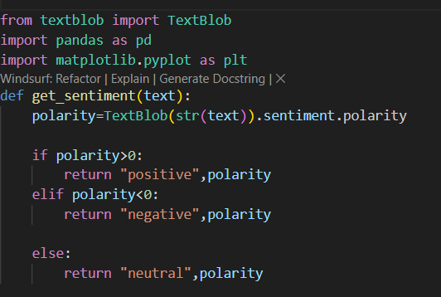
CODE EXPLANATION

Slide 9
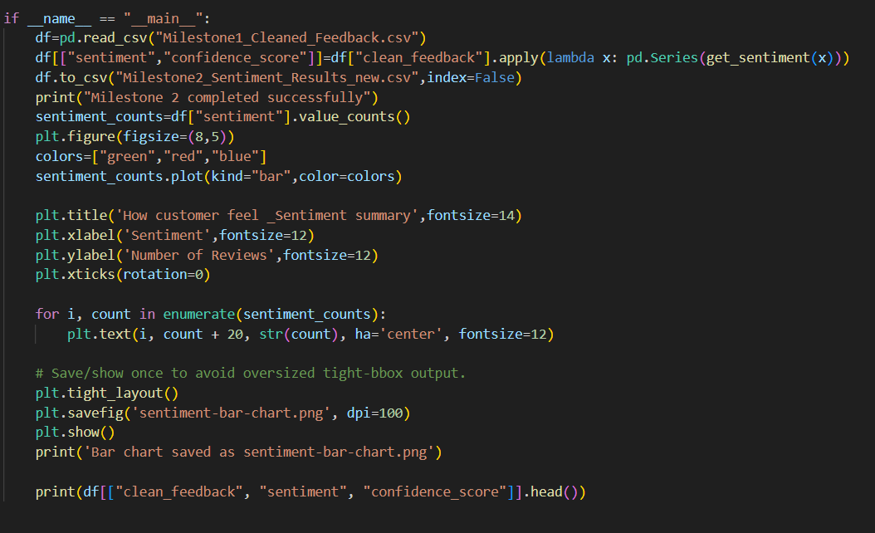

Slide 10
OUTPUT

Slide 11
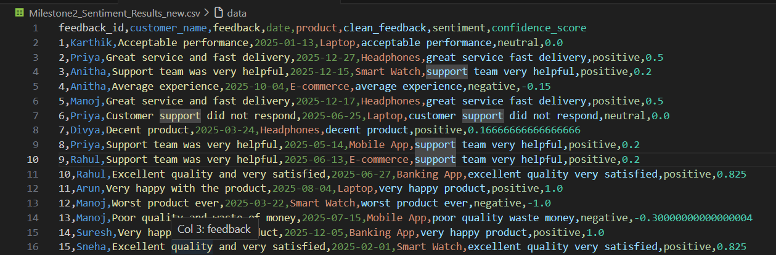
Output

Slide 12
Conclusion
Customer feedback is converted into clear Positive, Negative, or Neutral results.
The system automatically analyzes reviews quickly and accurately.

Slide 13
Review Sense – Milestone 3 Insight & Keyword Extraction & Frequency Analysis

Slide 14
Introduction to ReviewSense
ReviewSense analyzes customer feedback data
It helps businesses understand customer opinions
Milestone 1: Data cleaning
Milestone 2: Sentiment Analysis
Milestone 3: Keyword Extraction (Current focus)

Slide 15
Objective
Extract keywords from cleaned feedback
Count how frequently each word appears
Identify commonly discussed topics
Provide insights for business improvement
Generate a structured CSV output

Slide 16
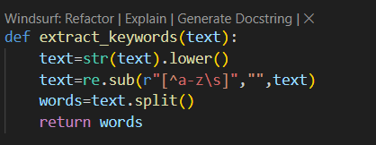
Keyword Extraction
Detects common customer concerns
Highlights frequently praised features
Helps identify product strengths & weaknesses
Supports decision-making process
Useful for visualization like word clouds

Slide 17
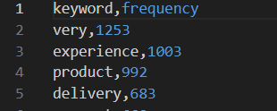
Input and Output Files
Input File:
Milestone2_Sentiment_Results_new.csv
Contains cleaned feedback text
Output File:
Milestone3_Keyword_Insights.csv
Columns: keyword, frequency
Sorted by highest frequency

Slide 18

Technologies
Python – Main programming language
pandas – Data handling and CSV processing
collections (Counter) – Frequency calculation
re (Regular Expressions) – Text cleaning

Slide 19
Working Process
Load cleaned CSV file
Extract feedback text column
Remove special characters using regex
Split text into words
Store all words in a list

Slide 20
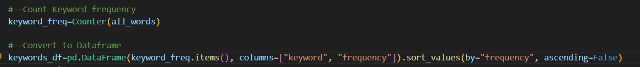
Frequency Calculation Process
Use Counter() to count word occurrences
Convert results into DataFrame
Sort by frequency (descending order)
Save results into new CSV file
Display top 10 keywords

Slide 21
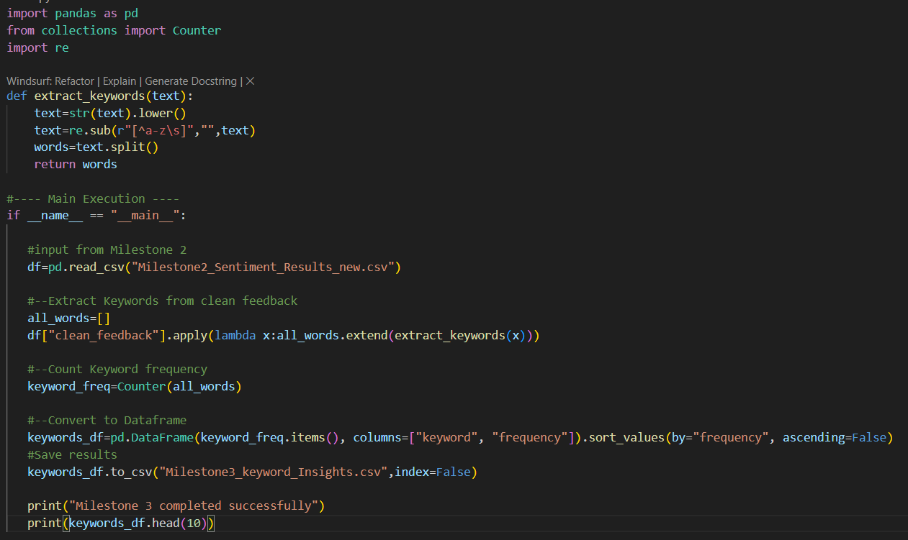
Code Explanation

Slide 22
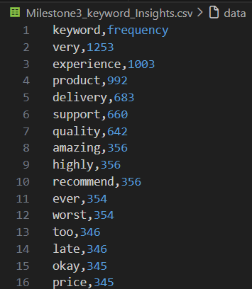
Output

Slide 23
Conclusion
Successfully extracted important keywords
Identified frequent customer discussion topics
Created structured insight file

Slide 24
Review Sense: Transforming Customer Feedback into Actionable Insights

Slide 25
Introduction
Final milestone of the ReviewSense project
Converts analyzed review data into interactive visual insights
Built using Python & Streamlit
Helps businesses understand customer sentiment clearly

Slide 26
Objective
Convert processed data into meaningful visual analytics
Allow dynamic filtering of data
Help stakeholders monitor customer satisfaction
Enable export of filtered insights for reporting
Goal: Turn raw data into business-ready insights.

Slide 27
Technology Stack
Python – Core programming language
pandas – Data processing and filtering
Streamlit – Interactive dashboard framework
matplotlib & seaborn – Data visualization
wordcloud – Keyword visualization
datetime – Date filtering

Slide 28
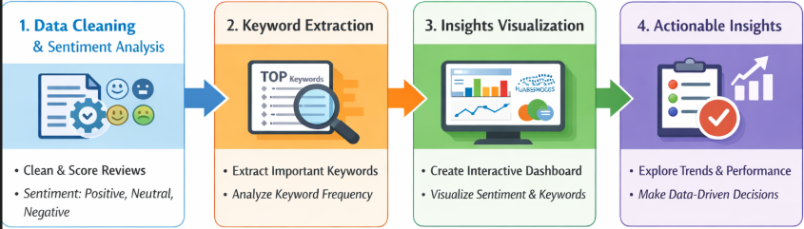
Workflow
ReviewSense follows a structured 3-step pipeline:
Data Cleaning & Sentiment Analysis (Milestone 2)
Reviews are cleaned and processed
Sentiment score is calculated
(Positive / Negative / Neutral)
Keyword Extraction (Milestone 3)
Important keywords are identified
Frequency of each keyword is calculated
Interactive Visualization (Milestone 4)
Processed data is displayed in dashboard format
Users explore insights dynamically

Slide 29
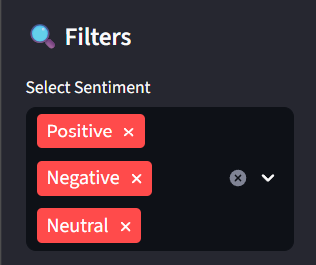
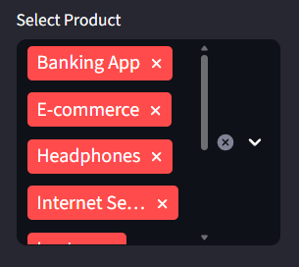
Dashboard Key Features
Interactive Features
Sidebar filters:
Sentiment (Positive / Negative / Neutral)
Product selection
Date range filter
Real-time KPI metrics:
Total Reviews
Positive %
Negative %
Neutral %
Filtered data preview
CSV download options

Slide 30
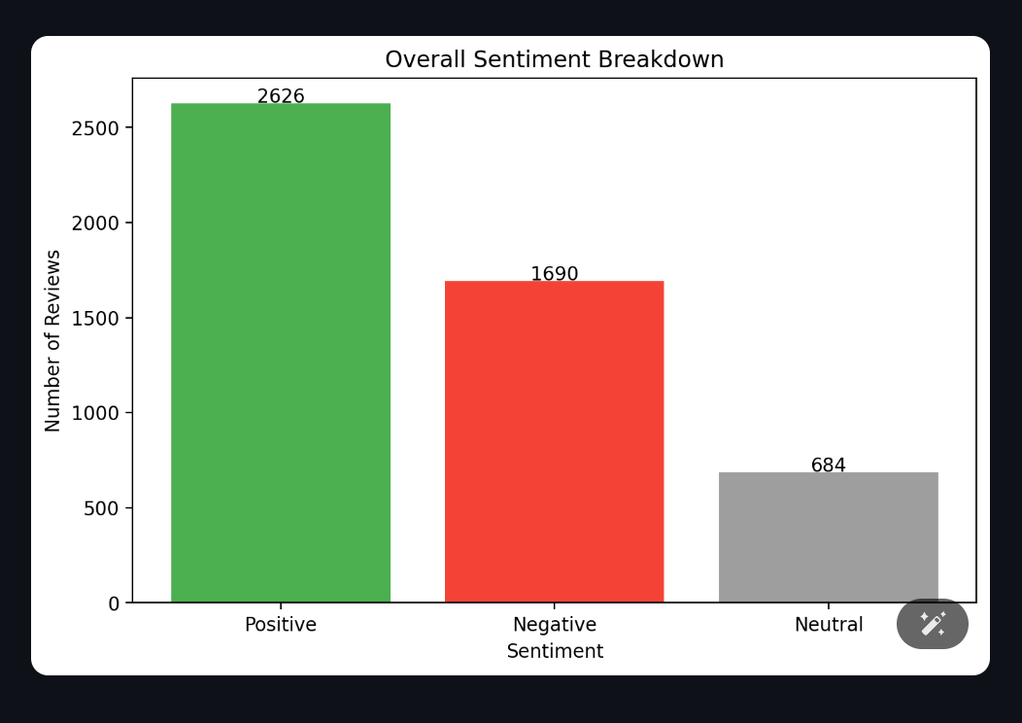
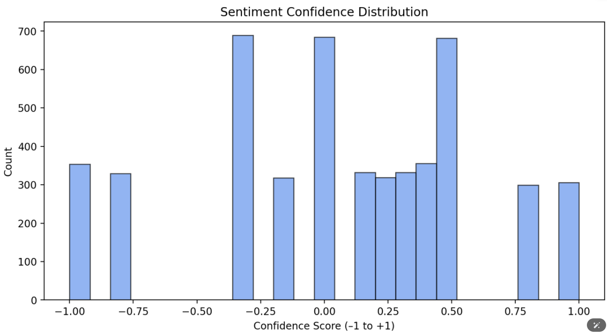
Sentiment Visualizations
Sentiment Distribution Bar Chart → Shows overall positive, negative, neutral counts
Monthly Sentiment Trend Graph → Displays how sentiment changes over time
Confidence Score Histogram → Shows strength of sentiment predictions

Slide 31
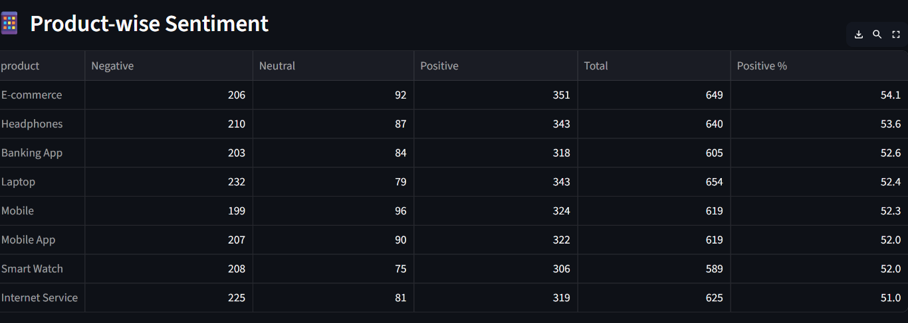
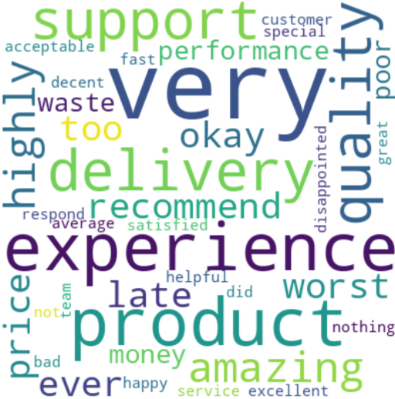
Keyword & Product Performance Insights
Product-wise Sentiment Analysis
Product sentiment summary table
Positive percentage ranking
Sentiment heatmap visualization
Keyword Insights
Top keyword frequency chart
Word Cloud visualization

Slide 32
Conclusion
Successfully converts large volumes of customer reviews into clear visual insights
Enables quick identification of customer satisfaction levels
Helps detect product strengths and problem areas instantly
Supports management in making faster, data-driven decisions
Improves overall customer experience through insight-based actions

Slide 34

Milestone-3
Overview
ReviewSense analyzes customer feedback reviews to identify frequently used keywords.
The system extracts keywords from cleaned feedback text and calculates how frequently each word appears.
It extracts important words and calculates how often each keyword appears in the reviews.
The results help identify customer concerns, product features, and common discussion topics.
Methodology
Input Data Loading-” Milestone2_Sentiment_Results_new.csv”
Keyword Extraction-Regular expressions remove numbers, symbols, and special characters.
Frequency Calculation-Counter() function, the program counts how many times each keyword appears.
Sorting Results-Sorted from highest frequency to lowest frequency to identify the most important terms.
Output Generation-The results are stored in a CSV file- “Milestone3_Keyword_Insights.csv”
Technological Stack
Pandas-loading and processing CSV datasets.
Collections (Counter)-count the frequency of each keyword.
Regular Expressions (re)-Used to clean the text data by removing special characters and numbers.

Slide 35
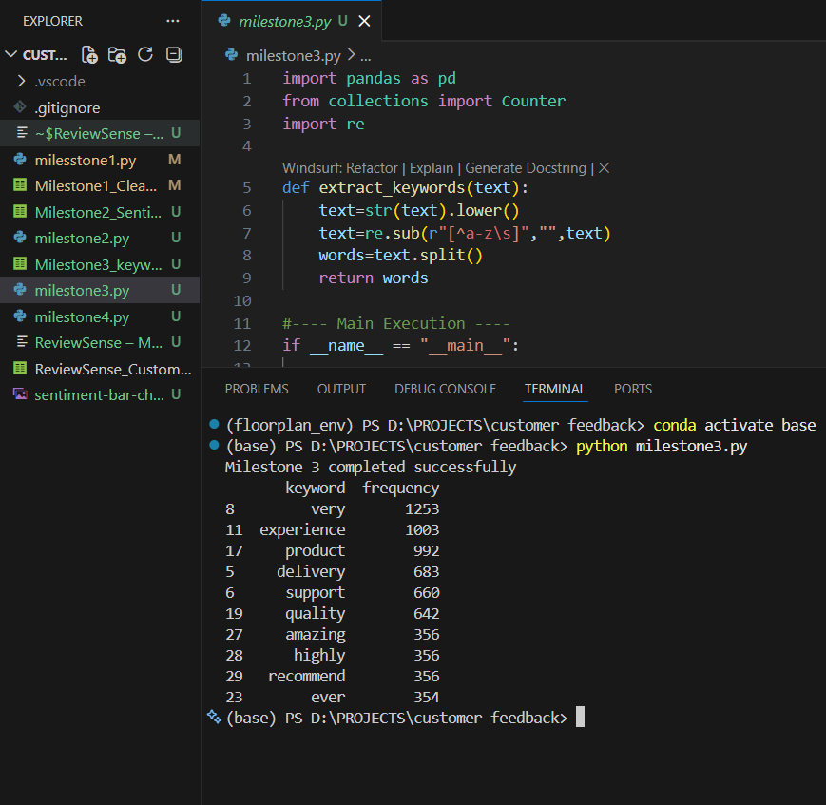
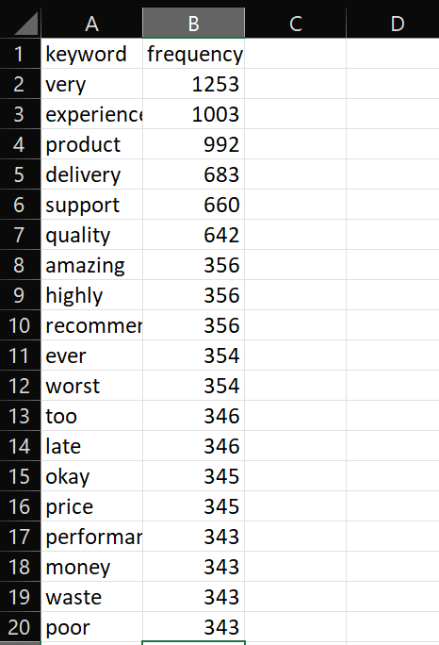
Milestone-3 Output

